Slide 1


Characterization and Particle Identification Using Skipper CCD Technology.
Daniel Pérez Chamorro
Co-Director: Núria Castelló-Mor
Co-Director: Rocio Vilar Cortabitarte

Slide 2
Index
Motivation
Dark Matter Principles
CCDs as Dark Matter detectors
Setup at IFCA: Commissioning of IRONMAN
Setup at CERN: Analysis of data from MOSKITA
Detection of hot columns
Particle classification via AI

Slide 3
Motivation
Dark matter was first proposed in the early 20th century. Many theories have emerged regarding its nature, but only a few properties are known.
The motivation for this work arises from the desire to contribute to the understanding of dark matter, my contribution is divided into two main parts:
Characterizing IFCA’s experimental setup for future applications (measure the lead 210 activity…)
Software development:
New methodology to detect hot columns.
DNN for classifying particles and determining whether the number of muons increases with the luminosity of the LHC.

Slide 4
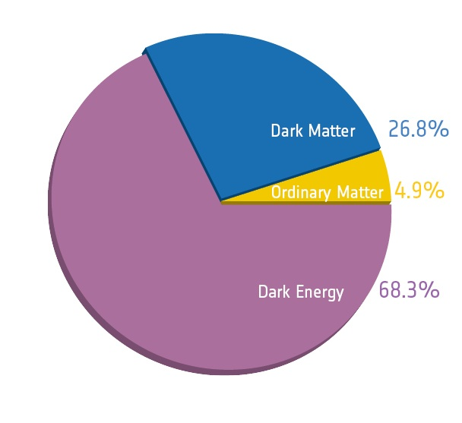
Composition of the Universe
What we know:
5% Ordinary matter
27% Dark matter
68% Dark energy (Universe expansion)

Slide 5
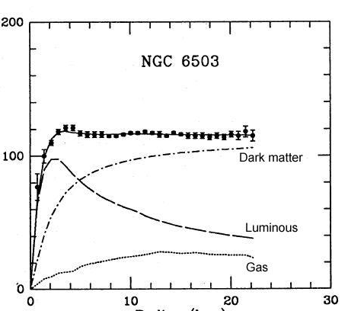
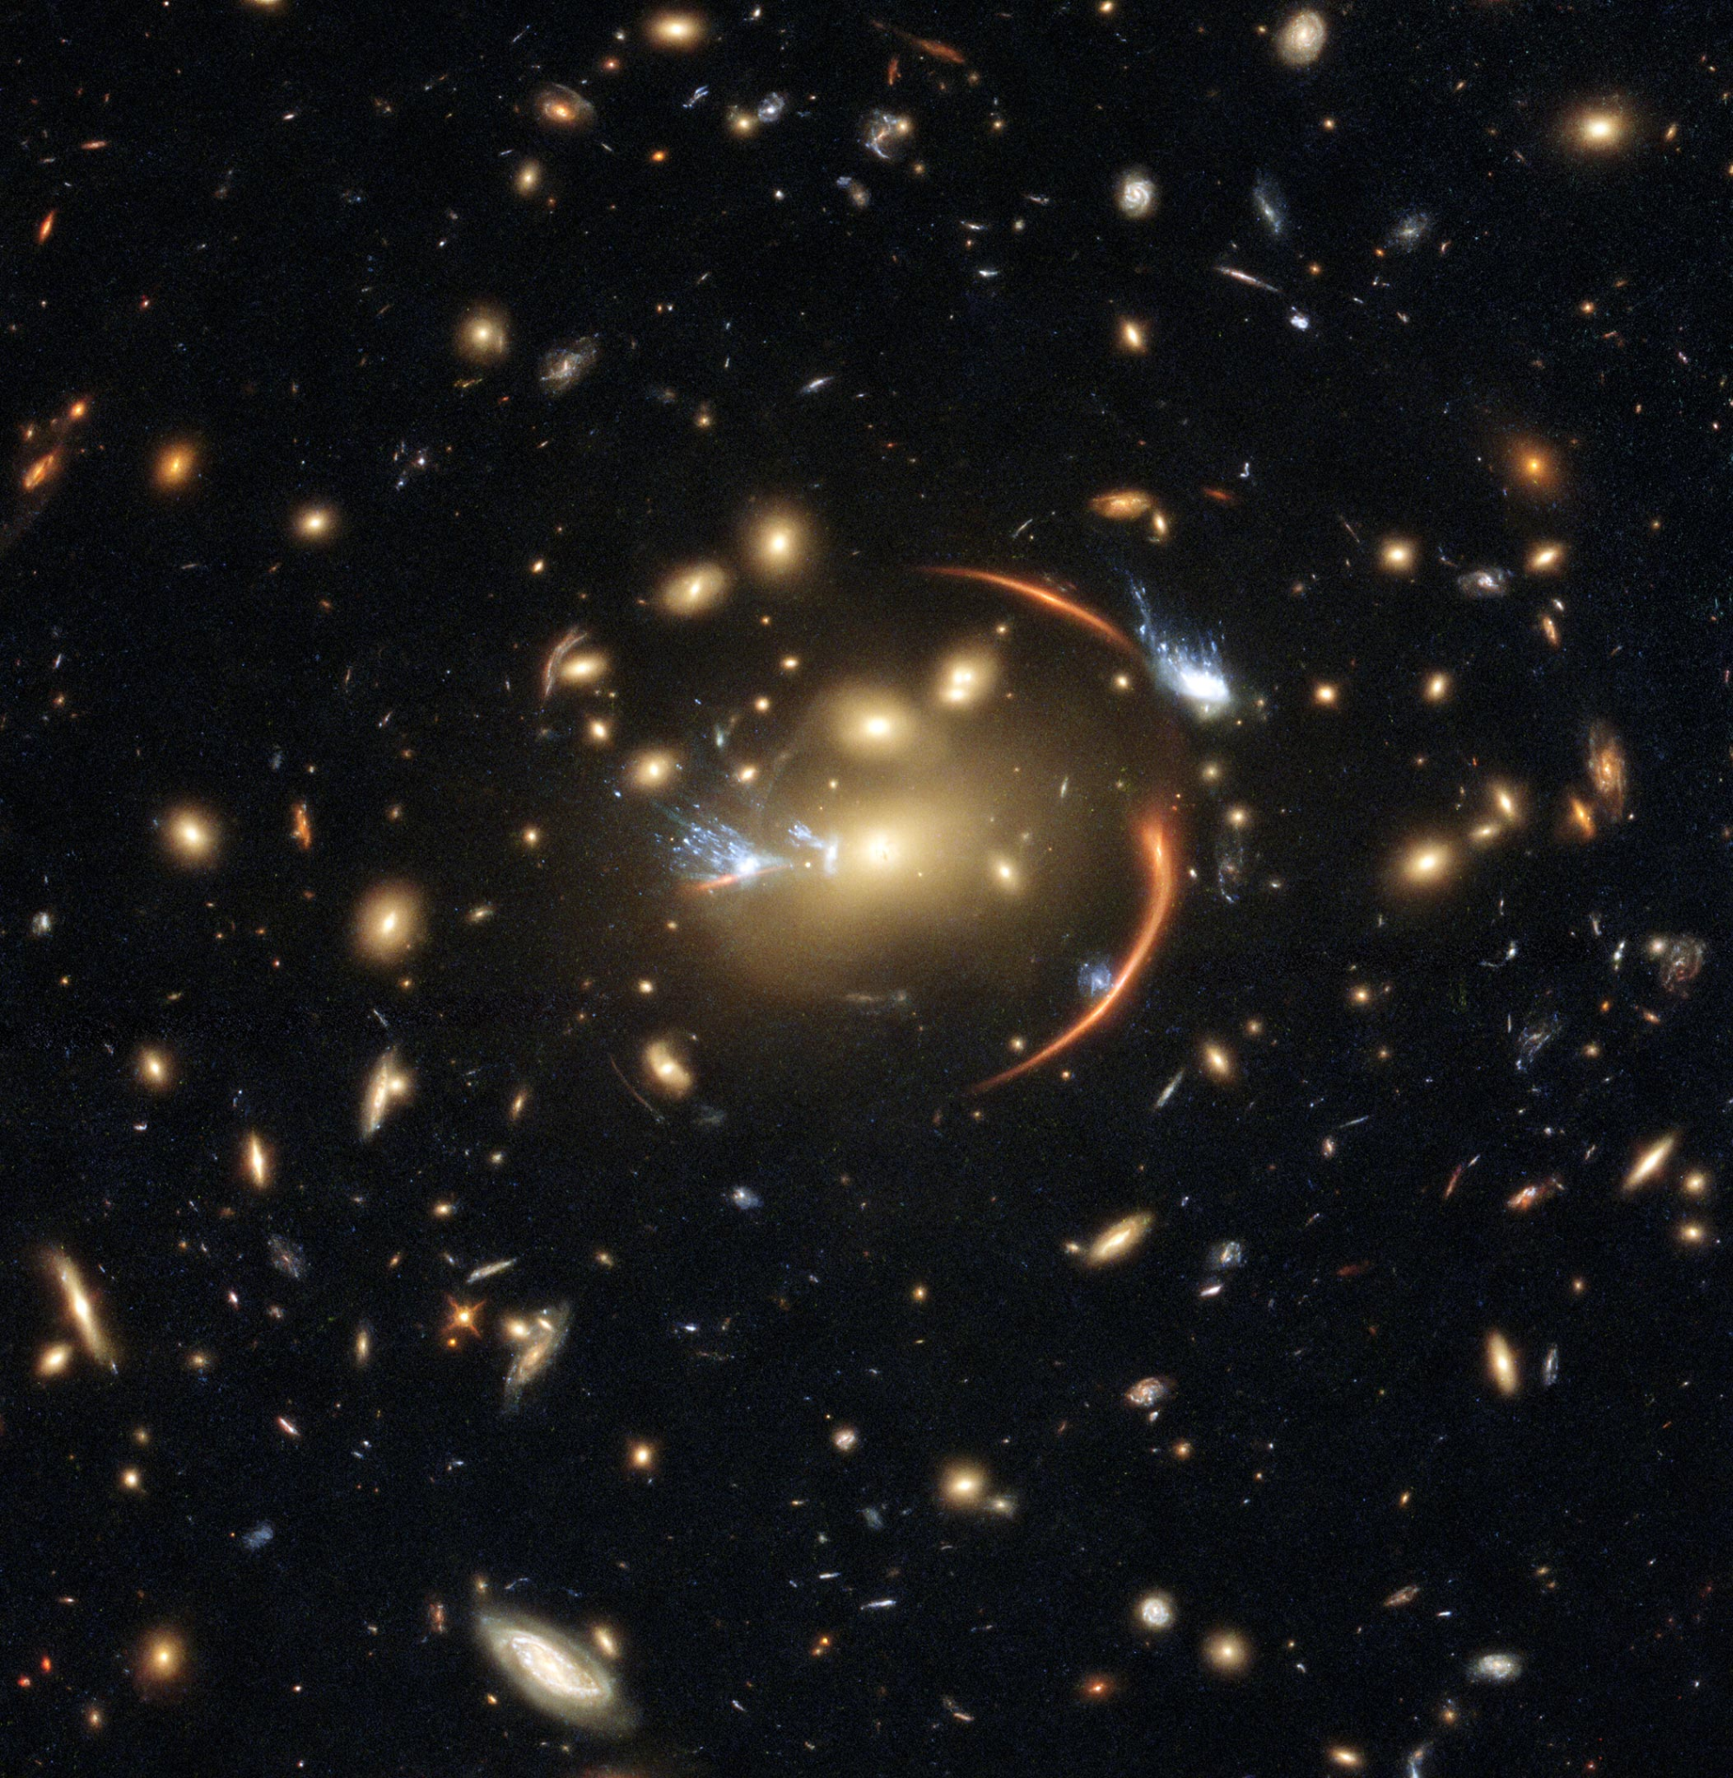
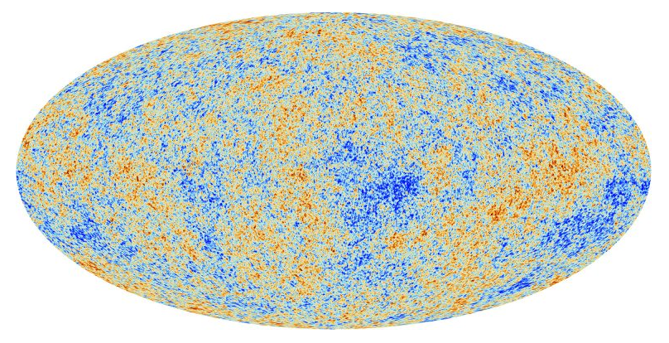
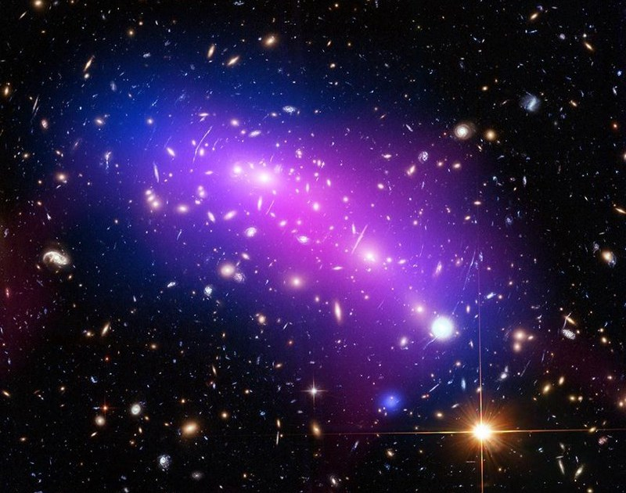
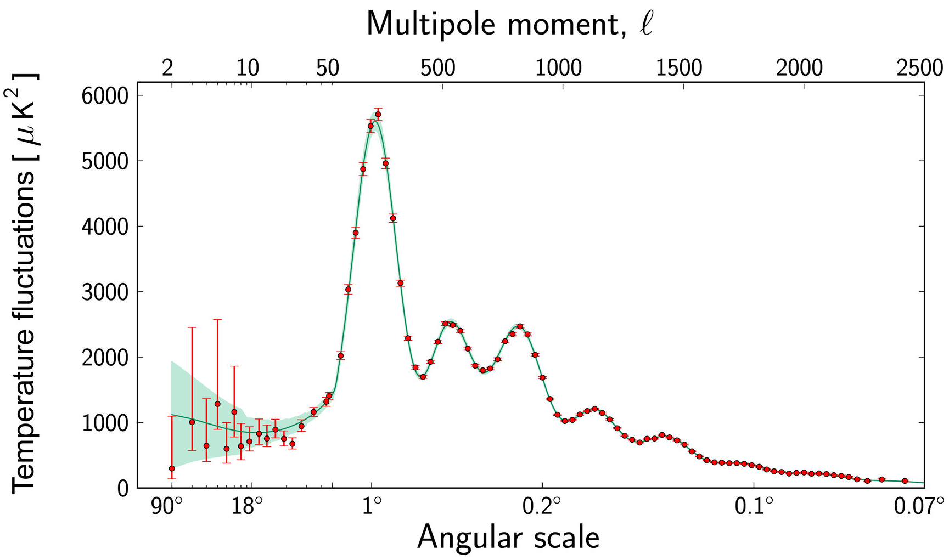
Existence of Dark Matter
Why we need Dark Matter:
Galaxy rotation curves
Structure formation
Cosmic Microwave Background (CMB)
Gravitational lensing
Cluster Collisions
Don't believe in MOND

Slide 6
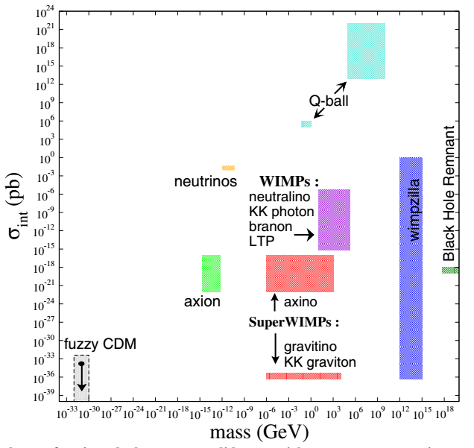
Generic Properties of Dark Matter
DM must be:
Massive
Neutral or milli-charged
Stable (very long lived)
Non relativistic (cold)
Only gravitational or very weakly interacting
Mass between 10-21 eV/c ~ 10 solar masses

Slide 7
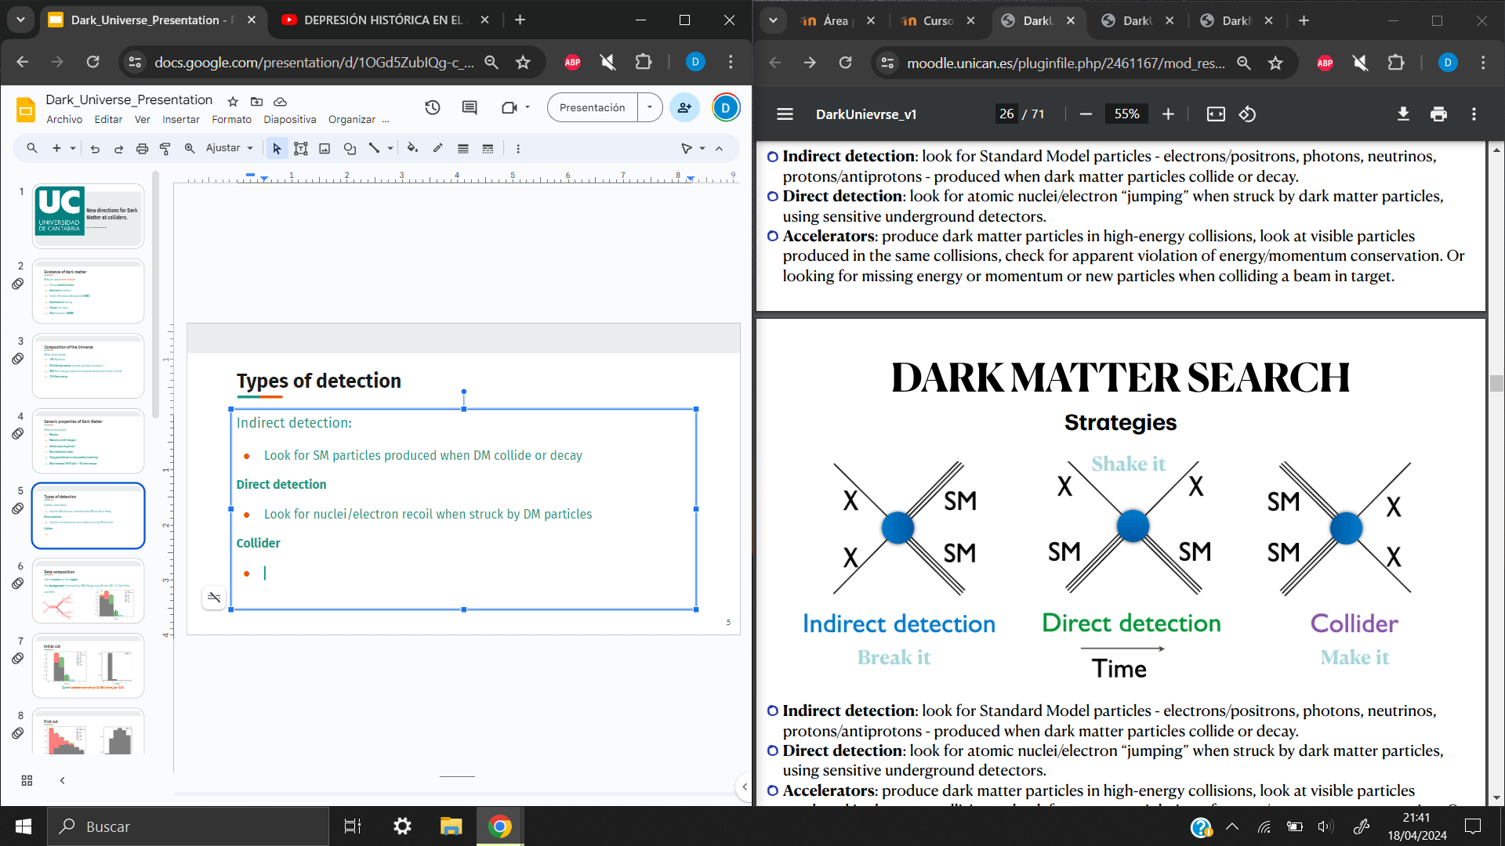
Types of Detection
Indirect detection:
SM particles by DM collision or decay
Direct detection
Nuclei/electron after DM collision
Collider
MET after SM collision

Slide 8
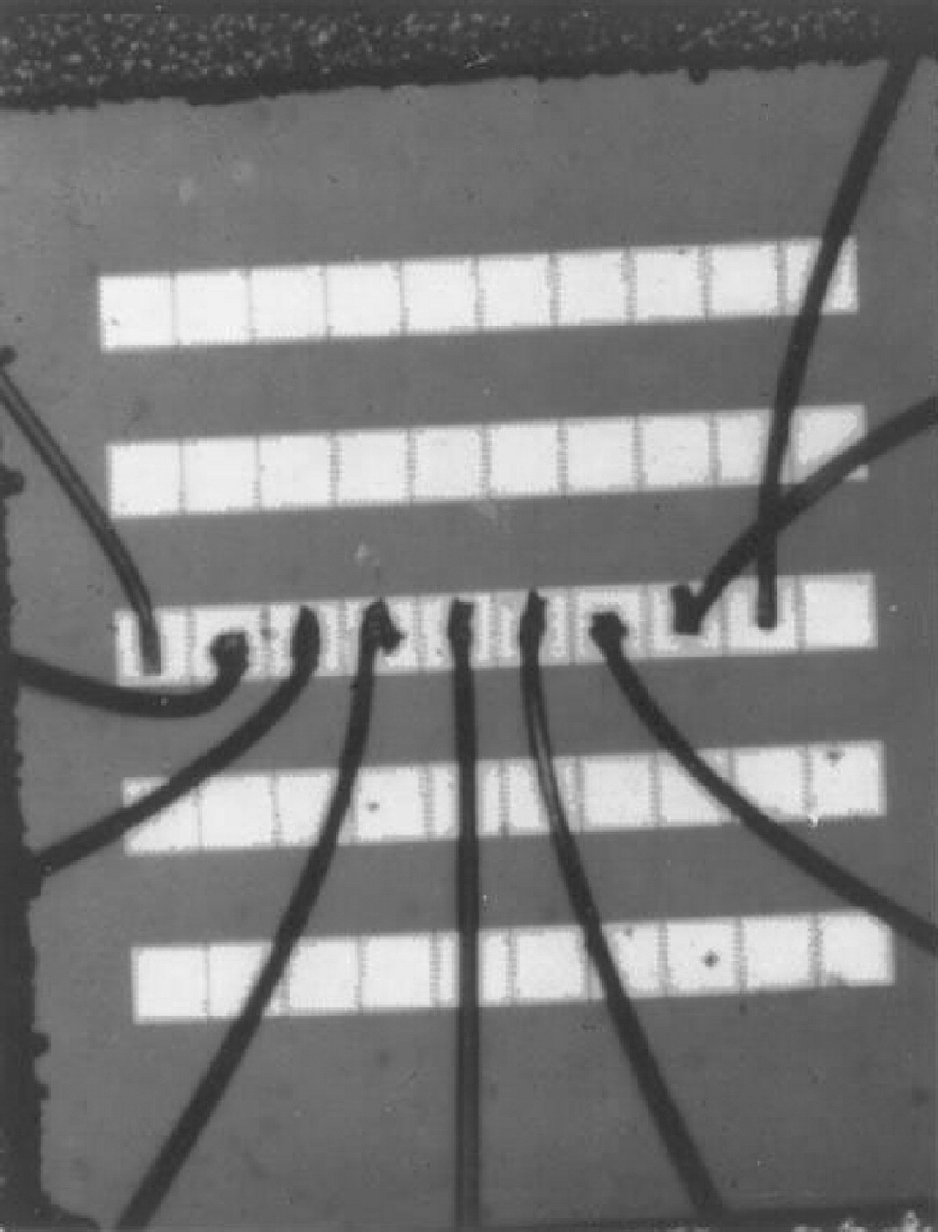
Charge Coupled Devices (CCDs) I
Invented in 1969 by Willard S. Boyle and George E. Smith at Bell Laboratories.
Technology used:
Silicon diode array
Magnetic bubbles: 0 or 1, absence or presence of charge
MOS capacitors: Charge confinement
Originally conceived for memory devices but widely used for digital imaging cameras, telescopes and for DM searches

Slide 9
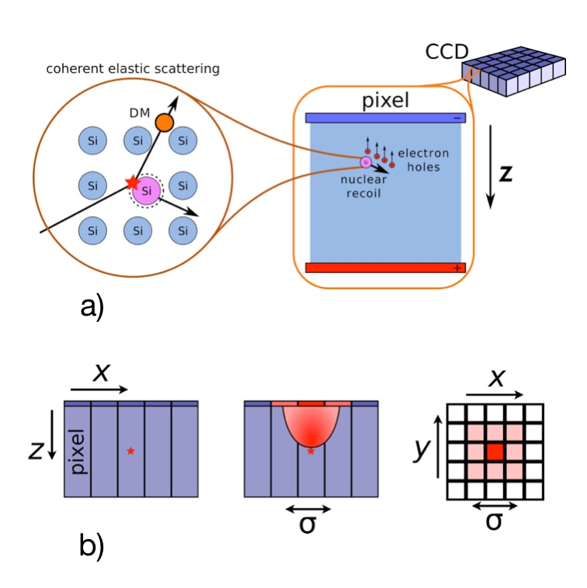
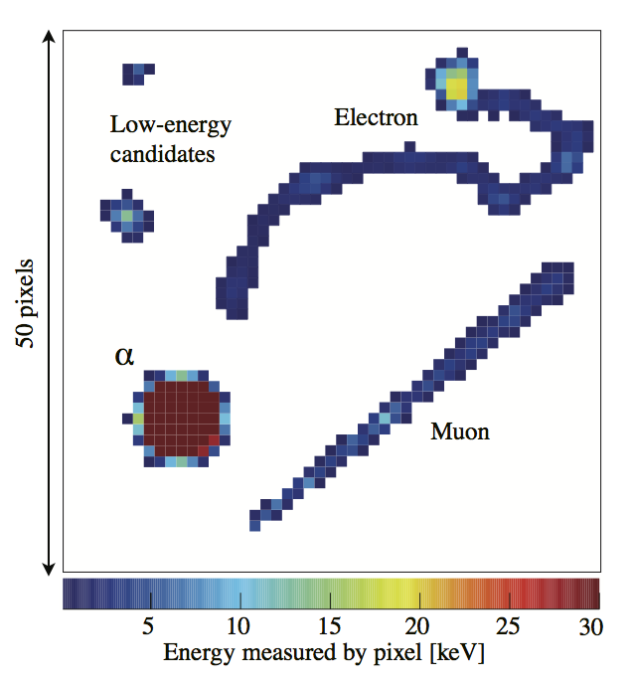
Diffusion Particle Trace
CCD is a semiconductor
Incident particles creates a pair e-h
Collect this e-h applying a bias voltage to generate an electric field.
Local Coulomb forces between the e-h inducing diffusion, the deeper more diffusion.
Possible to know the depth of the incident particle

Slide 10
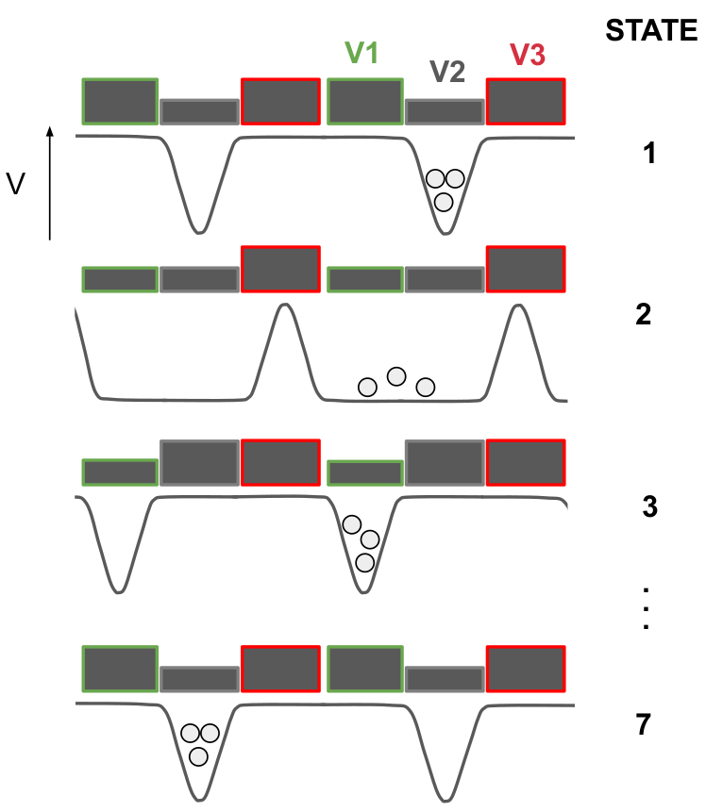
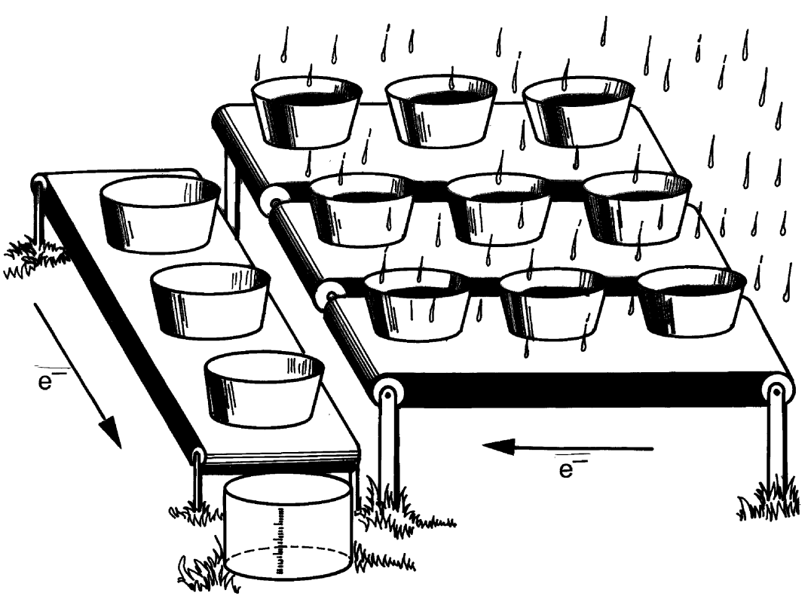
Charge Coupled Devices (CCDs) II
Each MOS is connected to a three-phase voltage source, called gates.
Charge movement is called Clocking.
Only move one gate at a time.
There are vertical clocks and horizontal clocks. Charge is moved vertically and then horizontally
The last row is called serial register
Notes:
Now, we have a device that is capable of store charge, but we need this charge to be moved for the readout. This is done

Slide 11
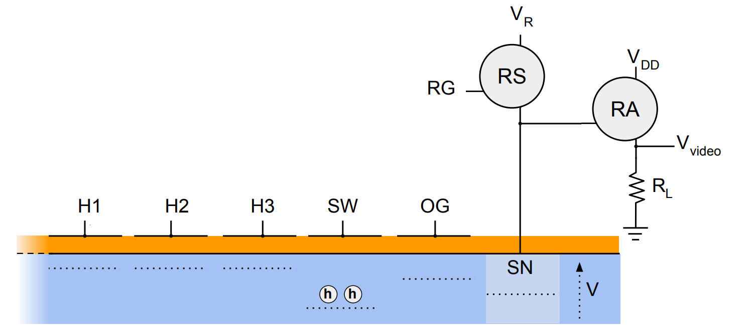
Charge Coupled Devices (CCDs) III
Before the readout, charge passes through a series of gates:
Transfer Gate: Regulates charge flow in the serial register.
Summing Well: Charge from one or multiple pixels is collected
Output Gate: Controls the flow between the SW and the SN
Sense Node: Measures the pixel charge and drain the charge

Slide 12
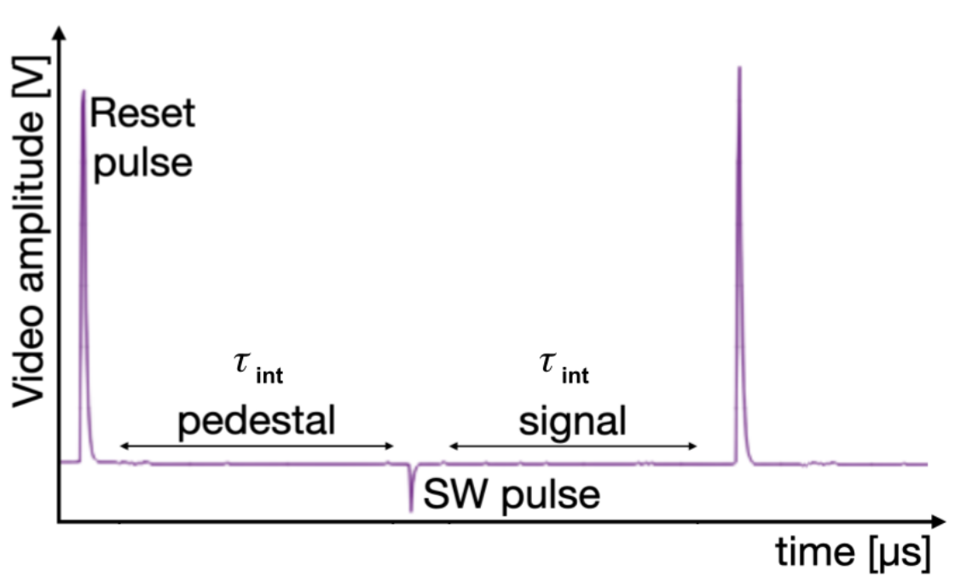
CDS Technique
Drain the charge with a reset pulse, injecting noise.
CDS Technique, consisting on measuring the charge at the SN twice:
First after the reset pulse, with no charge, measuring the pedestal.
Second once the charge has entered the SN, measuring the signal.
With the difference, only high-frequency noise is suppressed

Slide 13
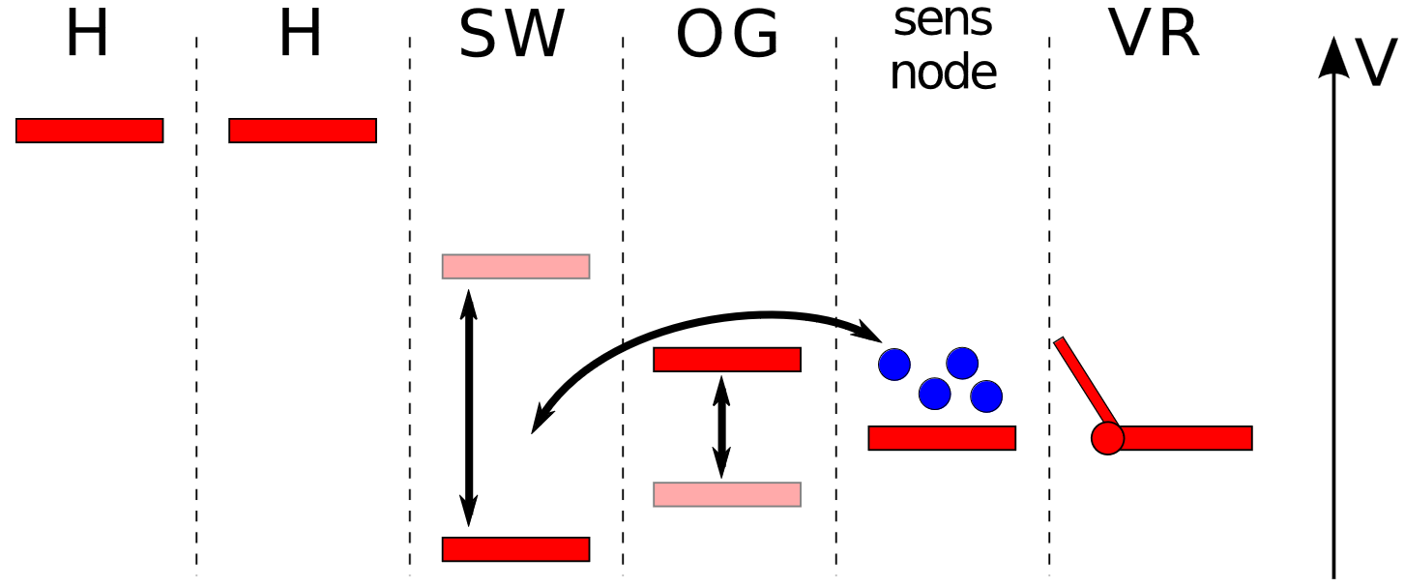
Skipper CCD Technology I
To remove the low-frequency noise, Janesick et al. proposed using a floating gate as the SN and perform repeated non-destructive measurements: ‘‘Skips’’.
Instead of draining the charge, move it to the SW and then to the SN. A new gate is introduced, the Dump Gate.

Slide 14
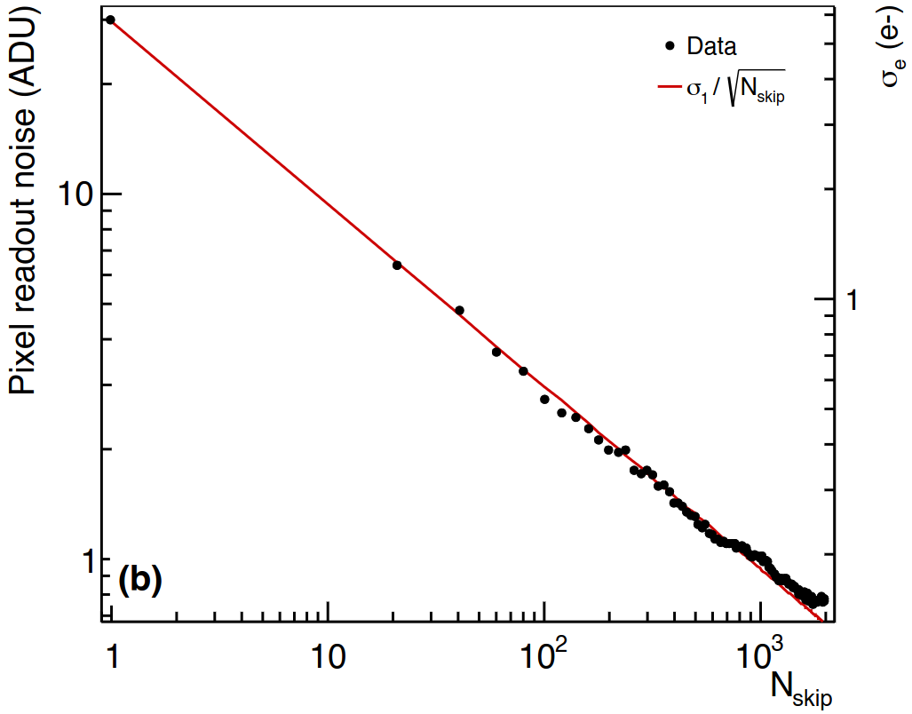

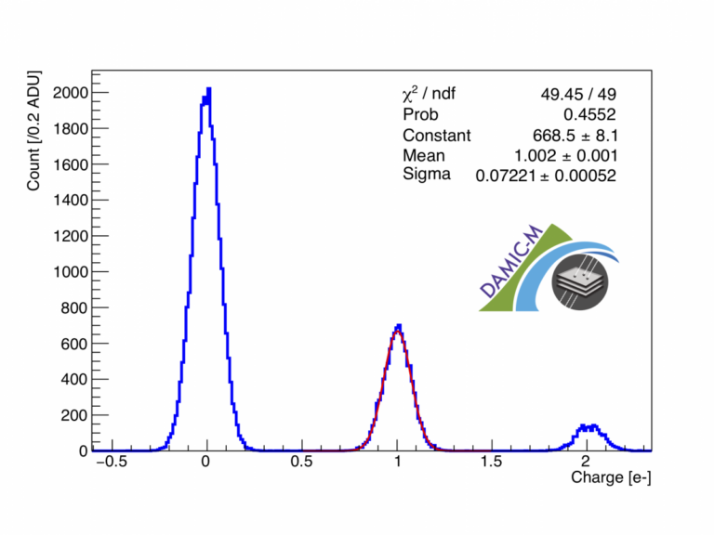
Skipper CCD Technology II
The readout noise decays as , making possible the single electron resolution:
Choose enough skips for the desired noise level.
Readout time also increases, leading to other backgrounds such as the dark current. This current arises mainly from thermal generation.

Slide 15
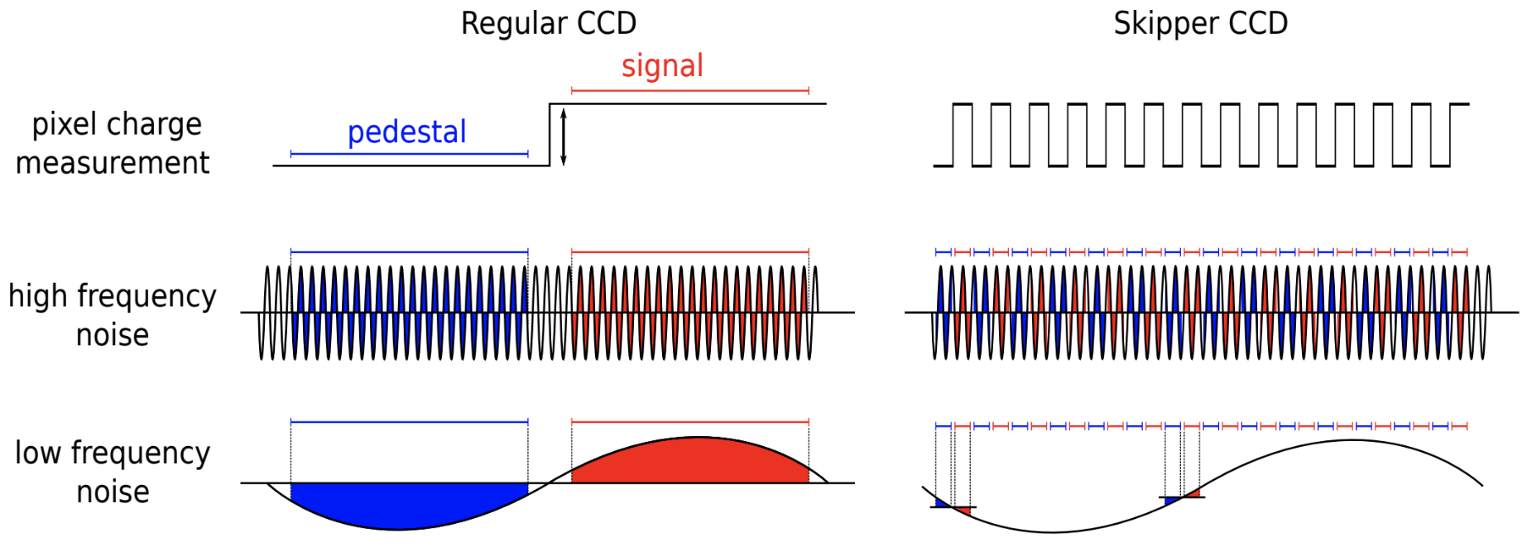
CDS vs Skipper Technology
CDS and Skipper technology comparison
Both techniques compensates high frequency noise
Skipper does faster and more measurements, compensating the low frequency noise

Slide 16
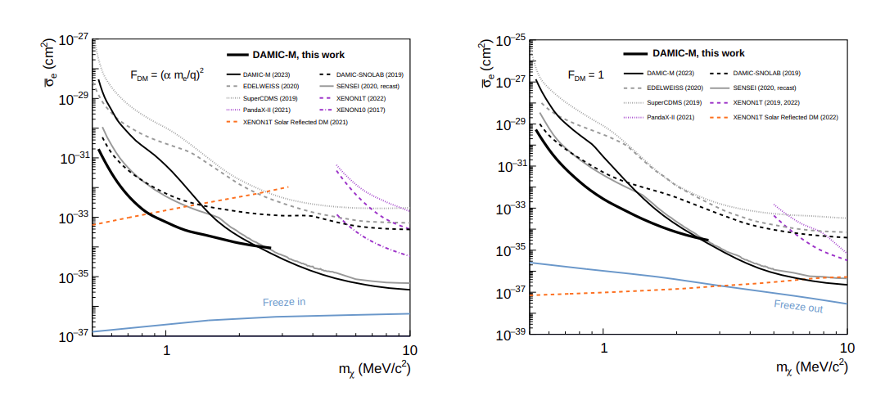
DAMIC-M Collaboration
Dark Matter In CCDs at Modane (LSM).
Extension from DAMIC Collab.
Larger CCDs (200 CCD). 2000 skips, noise 0.13e⁻, sensitive to 2-3 eV energies.
Current best constraints over the mass ranges [0.53, 1000] MeV/c2 and [0.53, 15.1] MeV/c2 for ultralight and heavy mediator interactions.

Slide 17
1st Objective of the TFM: IRONMAN Setup
To establish an optimal lecture setup for Skipper-CCDs, with the new LTA readout system. First step to build the radiopurity facility at Canfranc.

Slide 18
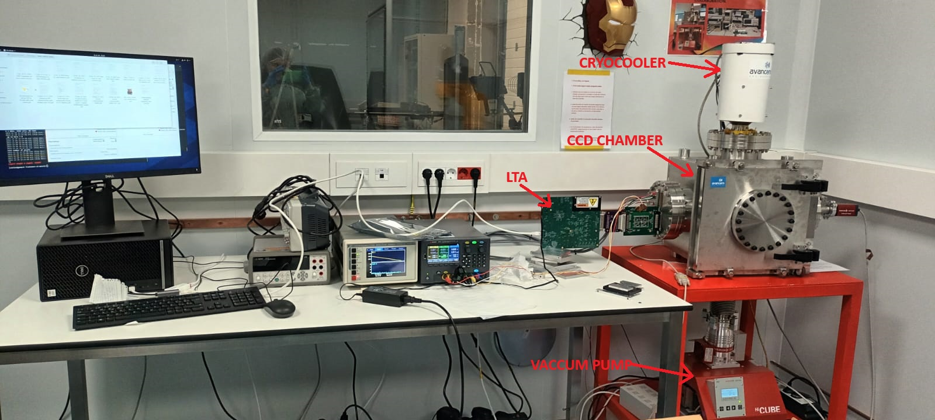
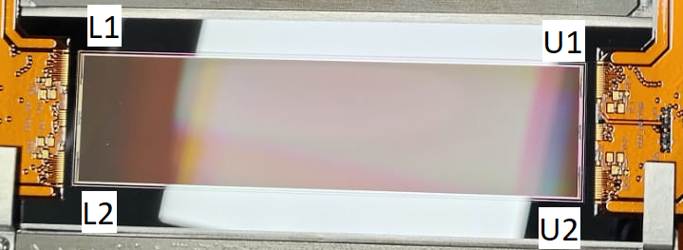
IRONMAN Setup
Cryocooler: reduce the T to 130K, rate of 0.015 K/s
Slow Control: component to remotely operate and monitor the setup
Vacuum pump: Pressure to 10^{—8} mbar, preventing condensation or impurities
CCD Chamber: Stainless steel, isolates the CCD
CCD: Non-scientific, 6144x1536, four amplifiers
LTA: DAQ system, specifically design, noise performance and compact design

Slide 19
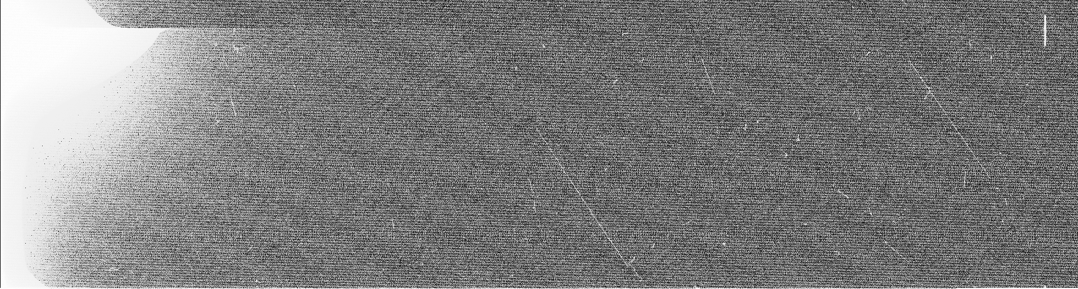
Characterization I
Start with the CCD-PP52, only one amplifier working.
Observe: Traces but with glowing, correlated noise and a defect
No traces in the area
Same size and position
Same exposure time
Bckg. noise is gaussian at first orders

Slide 20
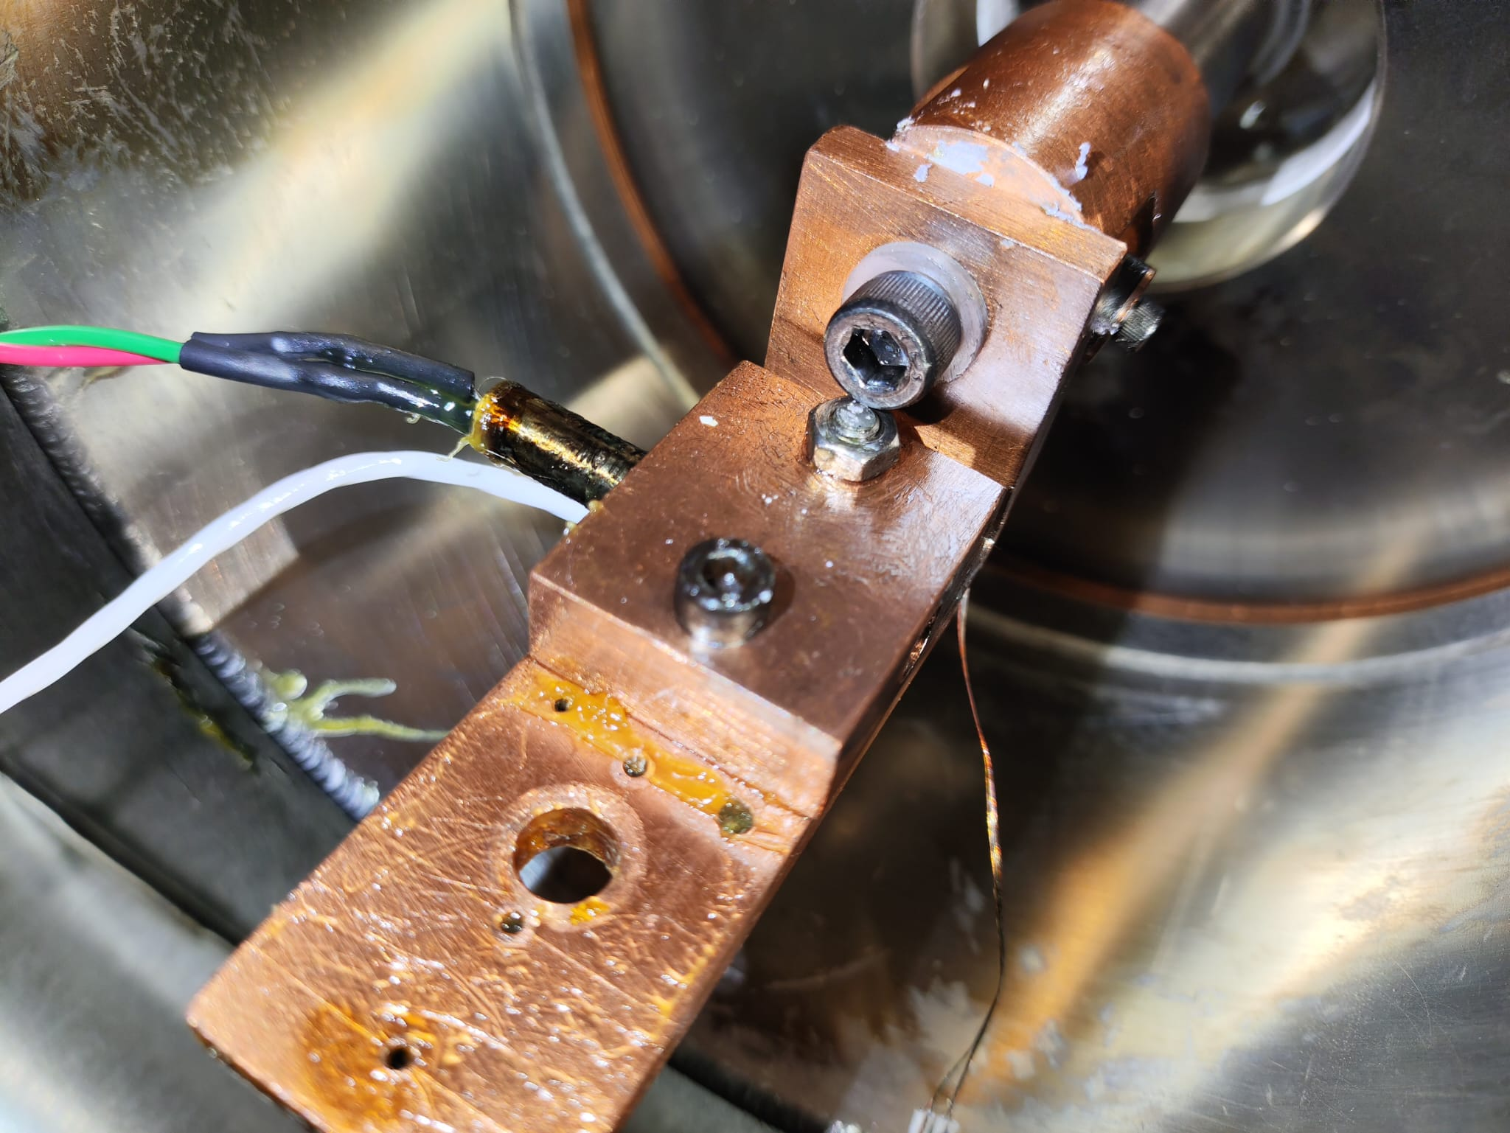
Characterization II
First try: Reduce the noise by connecting the LTA and vacuum pump to the chamber and left the cryocooler floating
correlated noise reduced.
Second try: Remove glowing unclocking the serial register 2
no results.
Third try: Check EM isolation in the chamber and change of CCD.
No isolation in the “L” copper bar, mounting the CCD and the cryocooler. apply thermal paste.
Additionally: Isolate the cables with Kapton flex. Connect the electronics to an UPS.

Slide 21
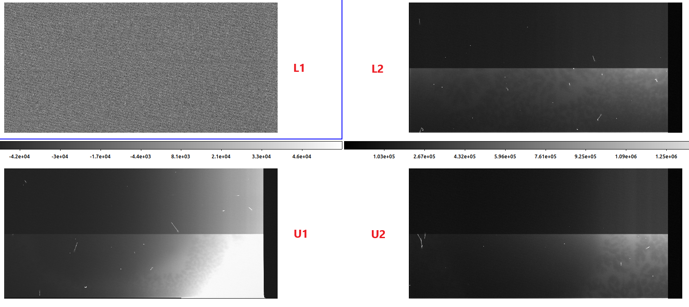
Characterization III
Ds9 distribution
New CCD:
Three working amplifiers
No correlated noise
Lower pedestal value
Less glowing
Translation and rotation of the images

Slide 22
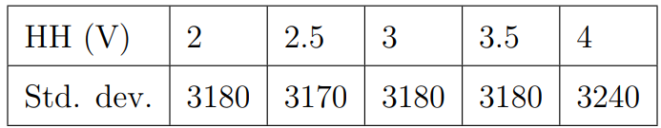
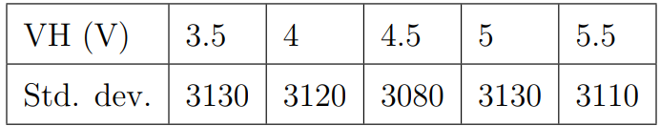
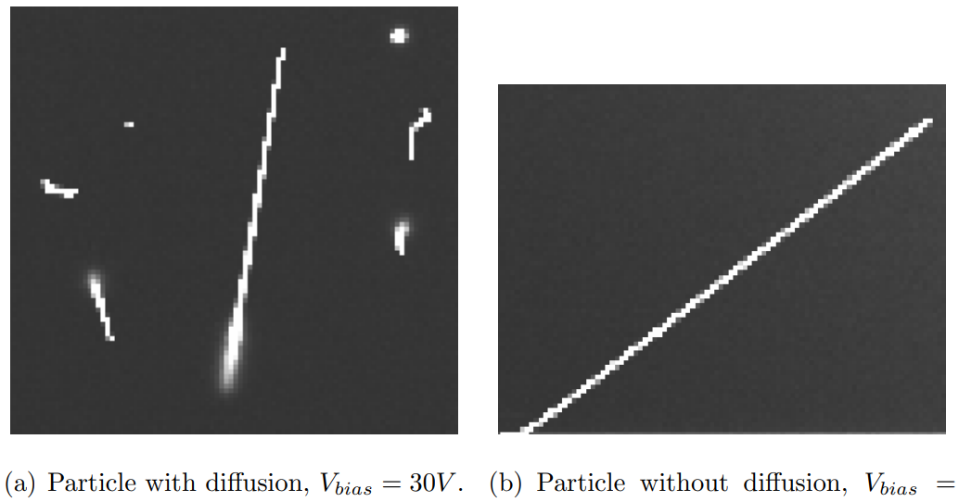
Characterization IV
Optimize Vertical and Horizontal gates voltage
HL fixed at 0.5V, HH between [2, 4]
Best for 2.5V
VL fixed at -1V, VH between [3.5, 5.5]
Best for 4.5V
Bias voltage to avoid diffusion.
Best for 40 V or 45 V
V = 30V
V = 40V

Slide 23
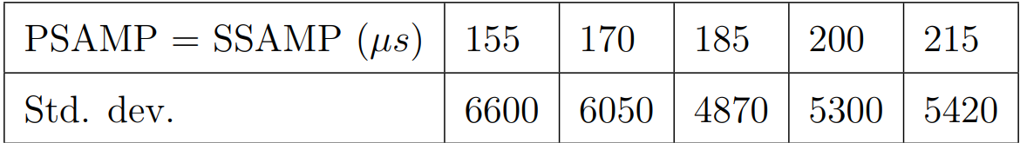
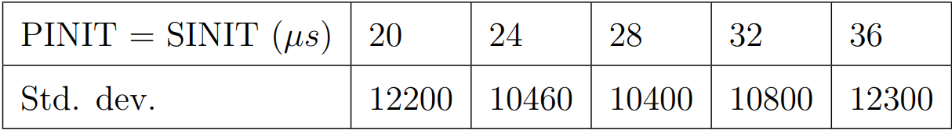
Characterization V
Integration time from CDS technique:
Best: 185 μs Best: 28 μs
Unclocking serial register to limit the glowing
Serial register 1: Still glowing
Serial register 2: Still glowing
Hypothesis: The L cooper bar is still not isolated
Pedestal/Signal measurement | After/Before the reset pulse

Slide 24
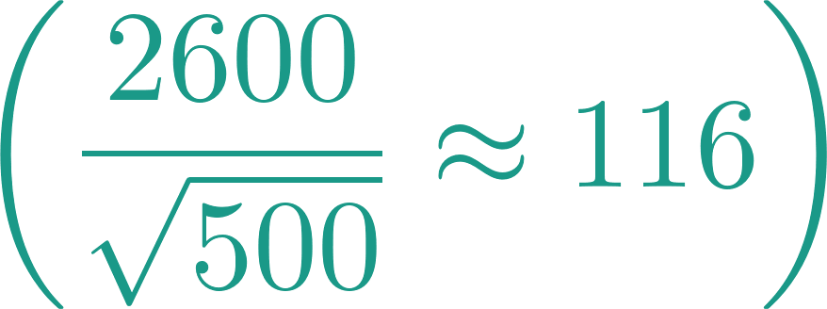
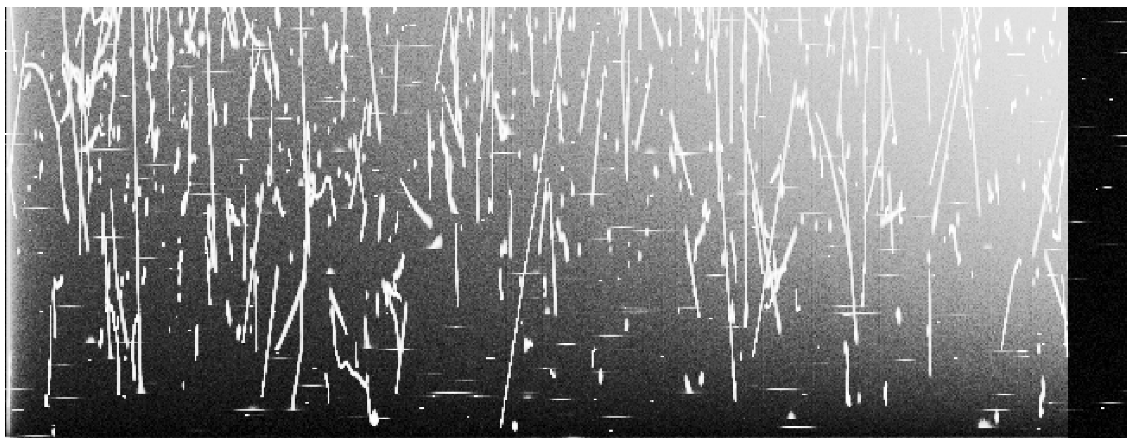
Skipper Images
Current Std. dev. Is 2600, we expect to decay with skippers.
With 500 skips decreases to 1400 , with 1500 skips increases to 2000.
Charge is been induced by glowing, saturating the CCD
Notes:
We have not been able to take high quality images to carry out a physical analysis

Slide 25
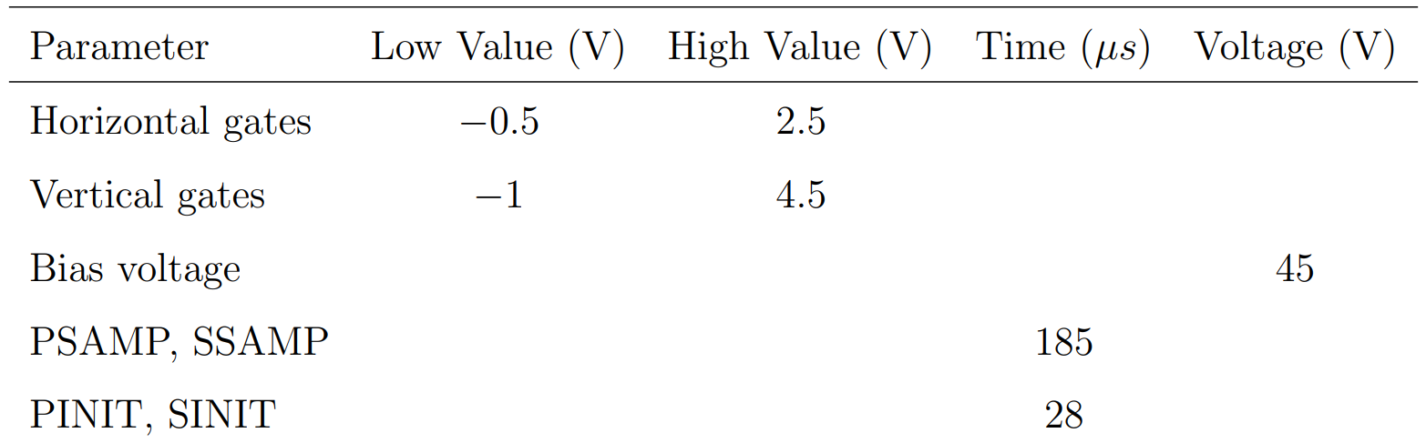
Characterization Results
Cannot optimize skipper parameters because of the image quality
The optimal parameters obtained are:

Slide 26
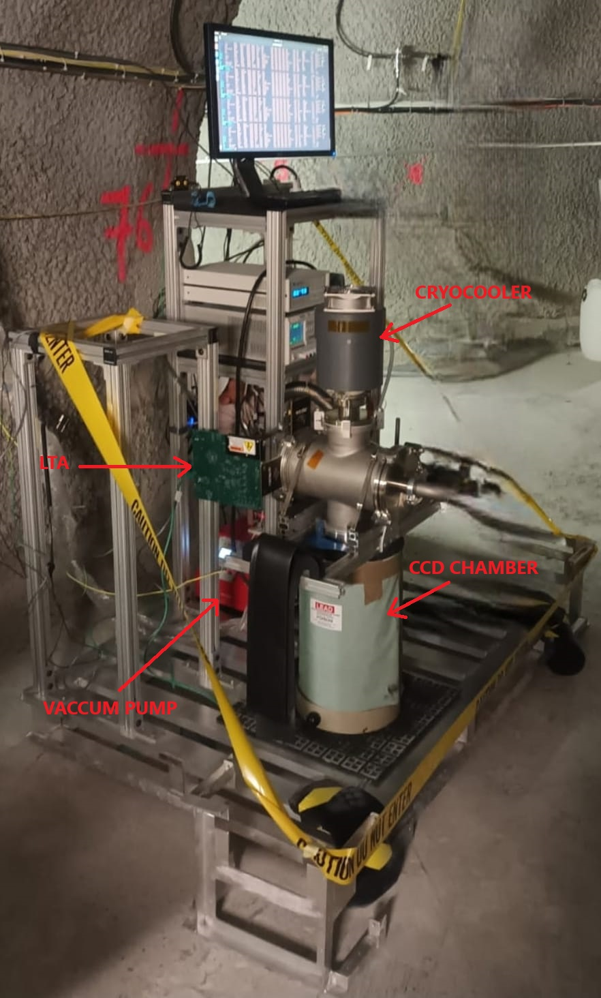
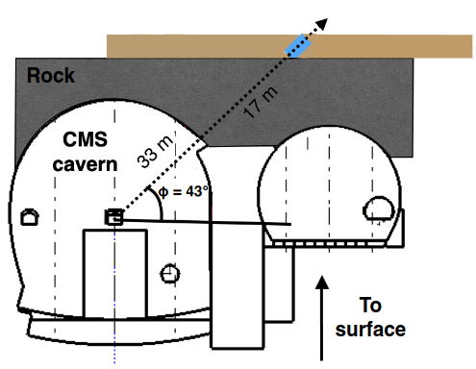
MOSKITA I
2nd Objective of the TFM:
Design and implementation of an automatic muon detection algorithm and integrate it in WADERS.
We use images from MOSKITA (MObile SKIpper Testing Apparatus)
setup located at CERN, because the poorly quality of IRONMAN images

Slide 27
MOSKITA II
MOSKITA will search for mCPs, hypothetical DM particles whose electric charge is a small fraction of the e–.
mCPs can be produced in high energy pp collisions.
The objective of MOSKITA is to assess the background and study the feasibility of such measurements.

Slide 28
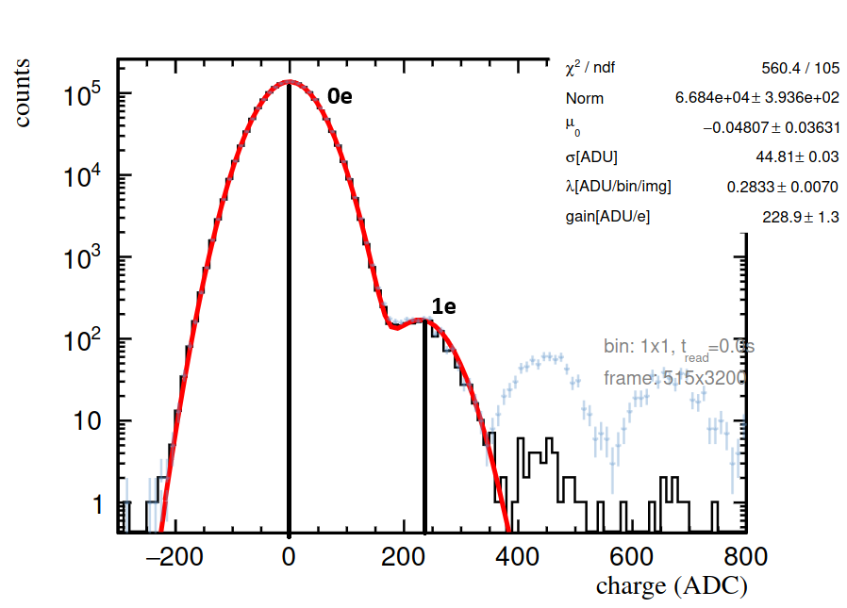
Data Cleaning
Process the images using a series of processes from WADERS
Compress Skipper Process: Makes the average of the measurement.
Pedestal Subtraction Process: Stimate the baseline for each row of the CCD
Cluster Finder: Identify particle tracks.
Build Cluster Mask: Cover clusters for analysis.
Apply Selection Cuts: Exclude areas from the detector.
Fit Dark Current Process: Determine the gain and dark current (dc). Obtain the noise, convert ADUs to e

Slide 29
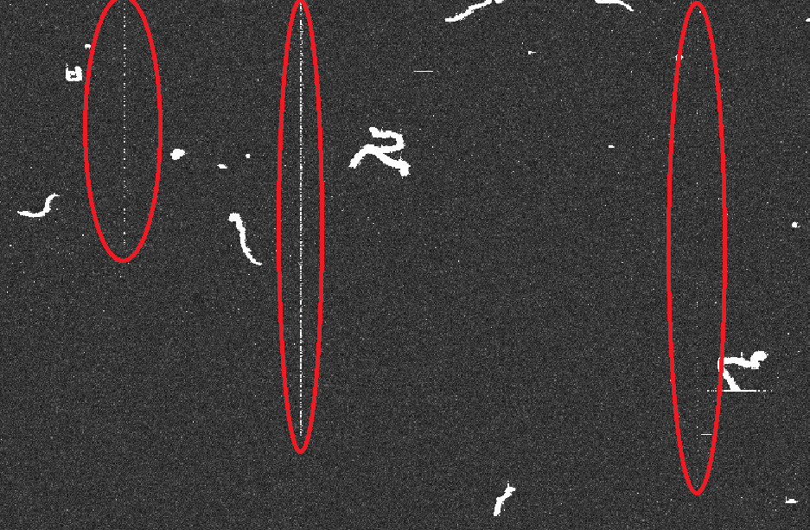
Hot Columns I
Defects in the silicon, creating wells that inject ‘‘fake’’ events into the CCD, with charge between 1 and 3e, same as the dc events, leading to bad calculations of gain and dc.

Slide 30
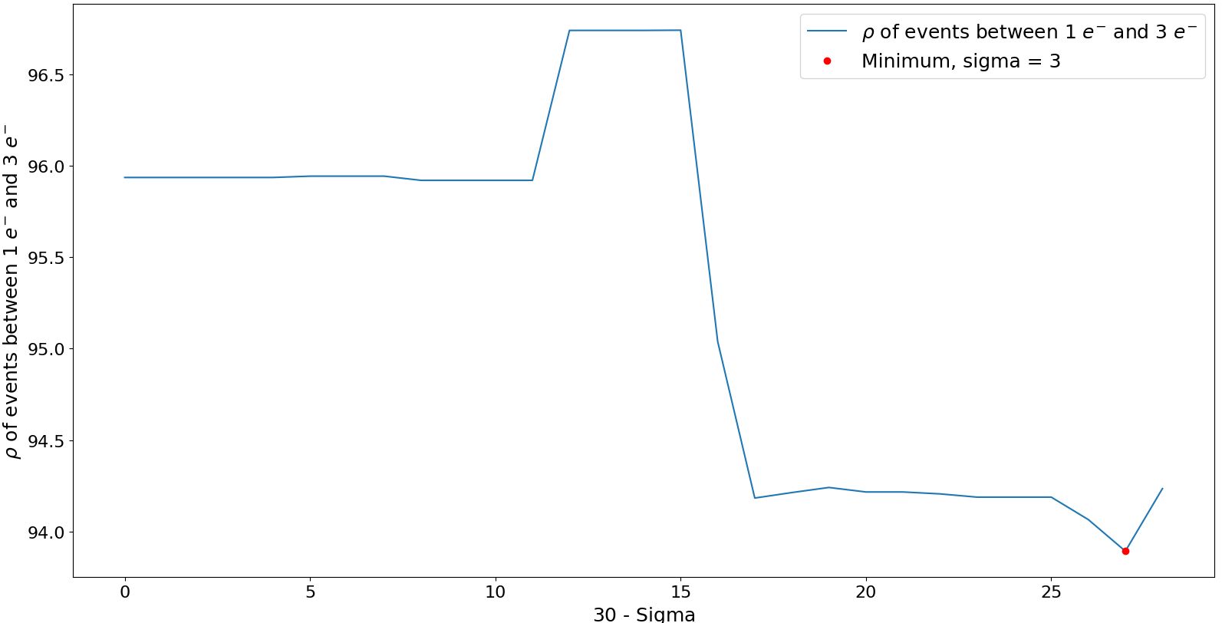
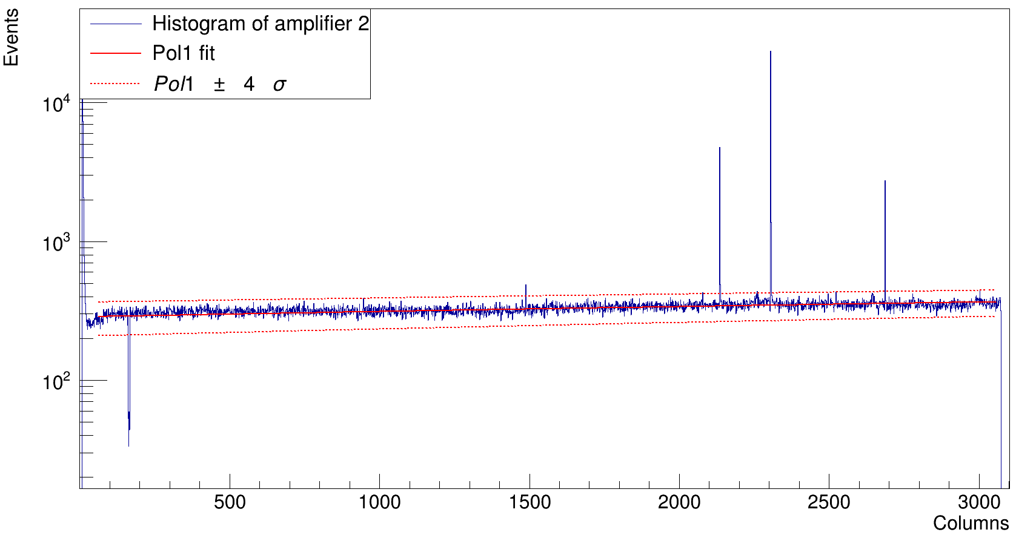
Hot Columns II
Plot the number of events with charge between 0 and 3e per column
Fit to a 1st order polynomial, removing the outliers and calculating the std. dev.
Values outside 4 sigma will be considered hot columns
Optimize the sigma value with the density of events vs the sigma Optimal value for sigma = 3

Slide 31
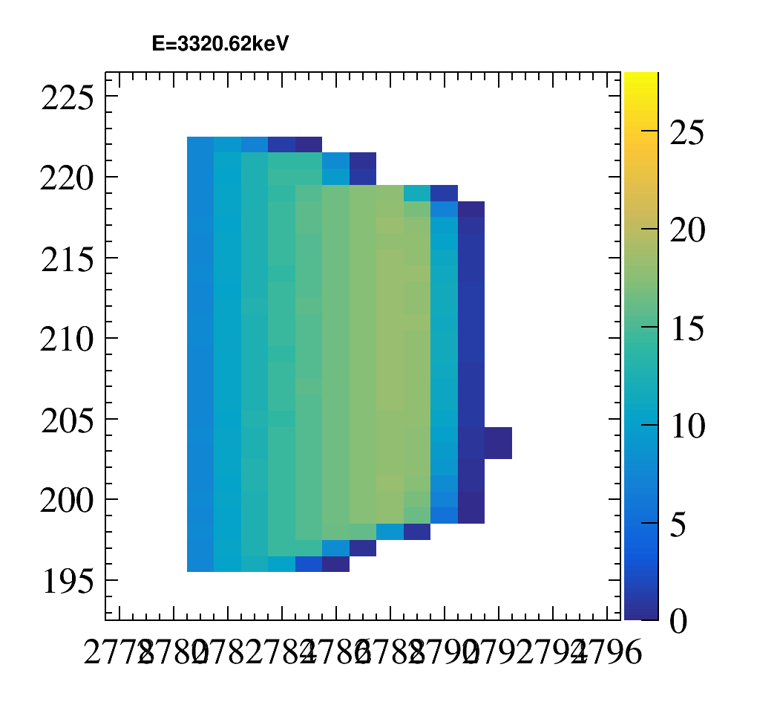
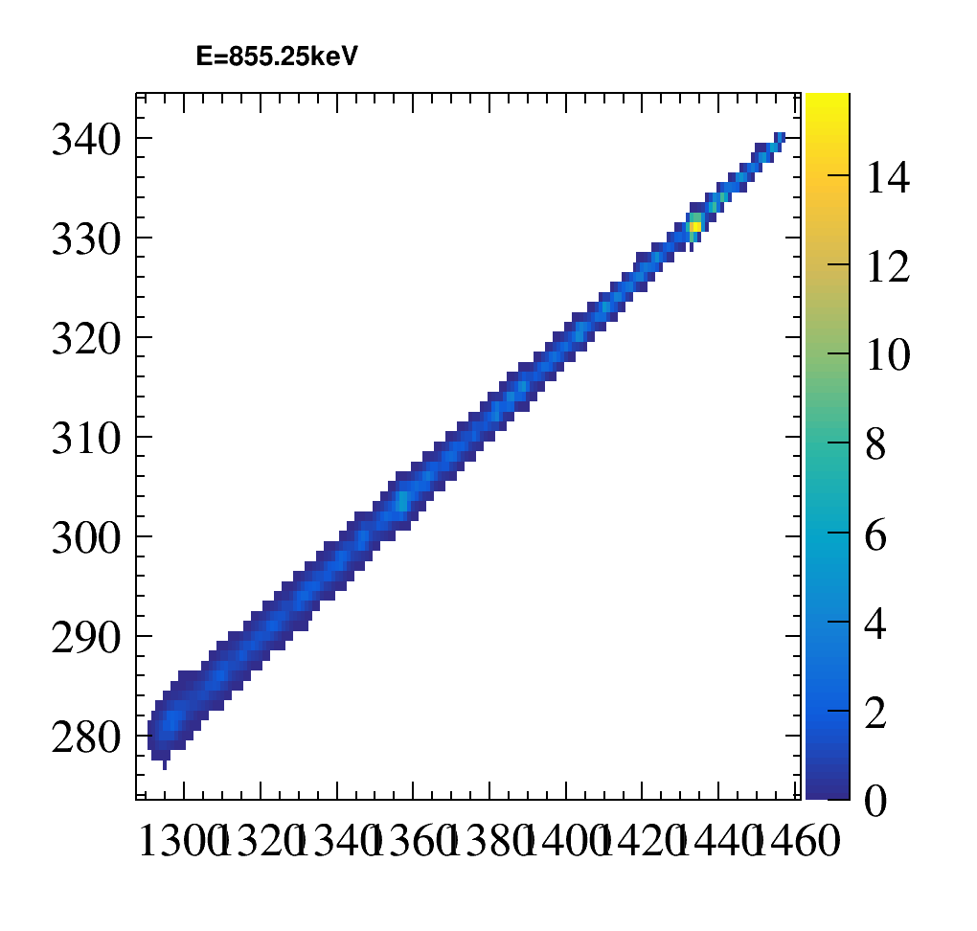
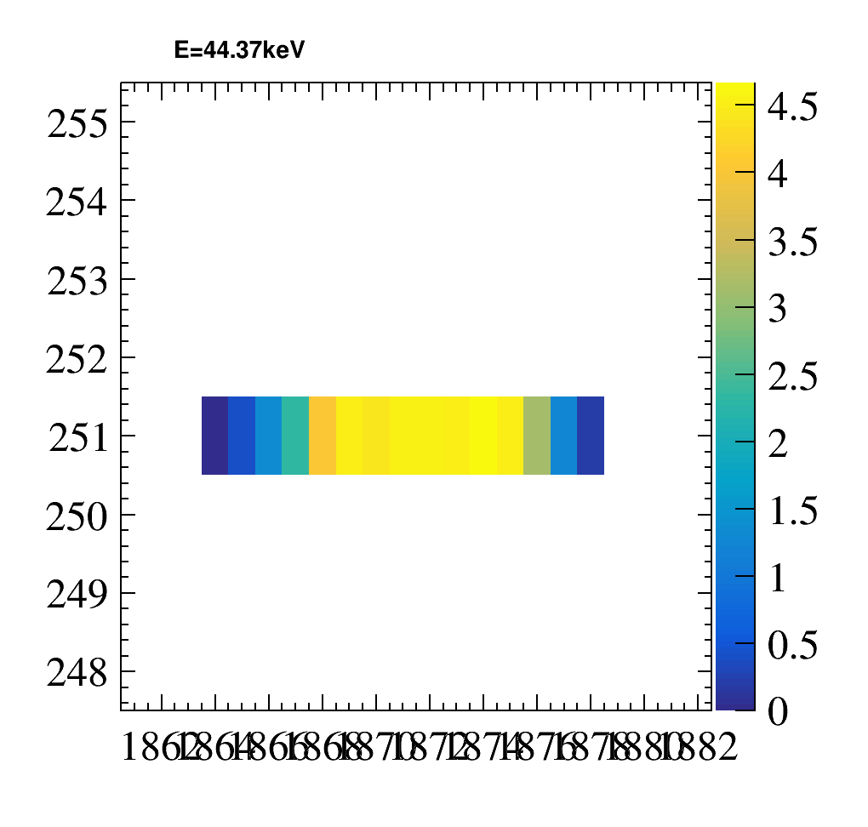
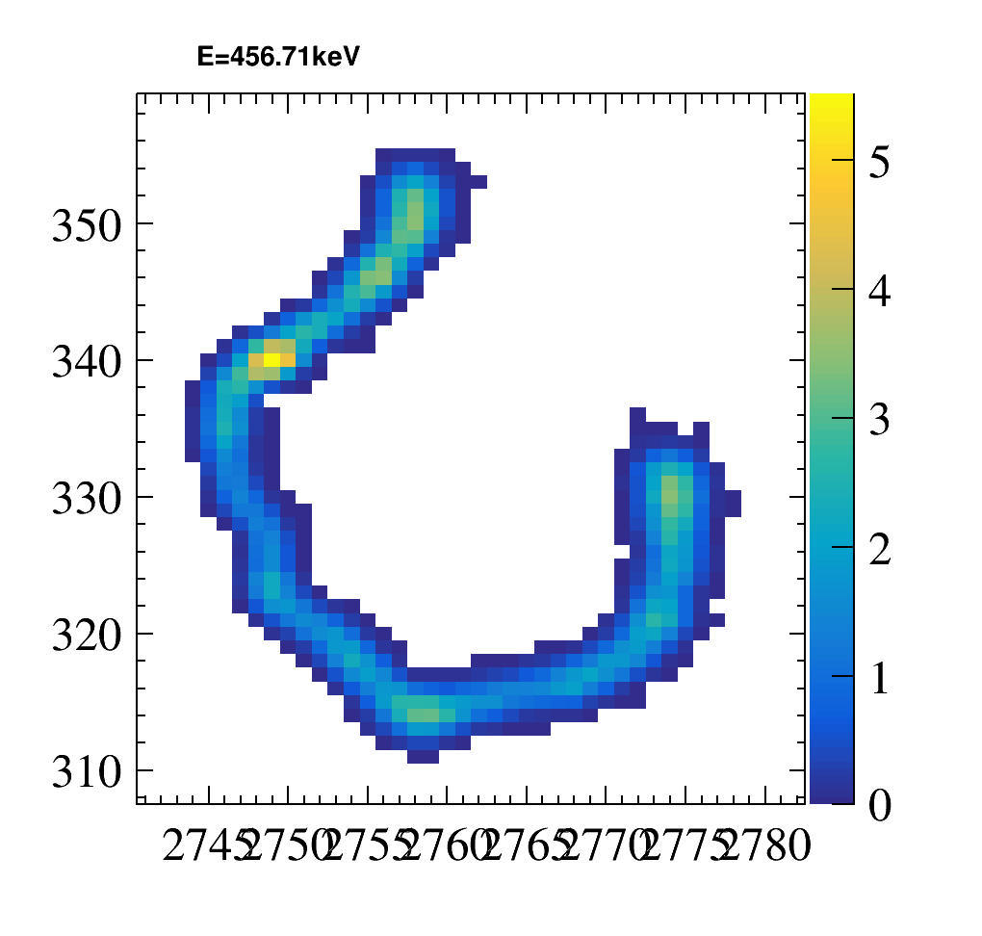
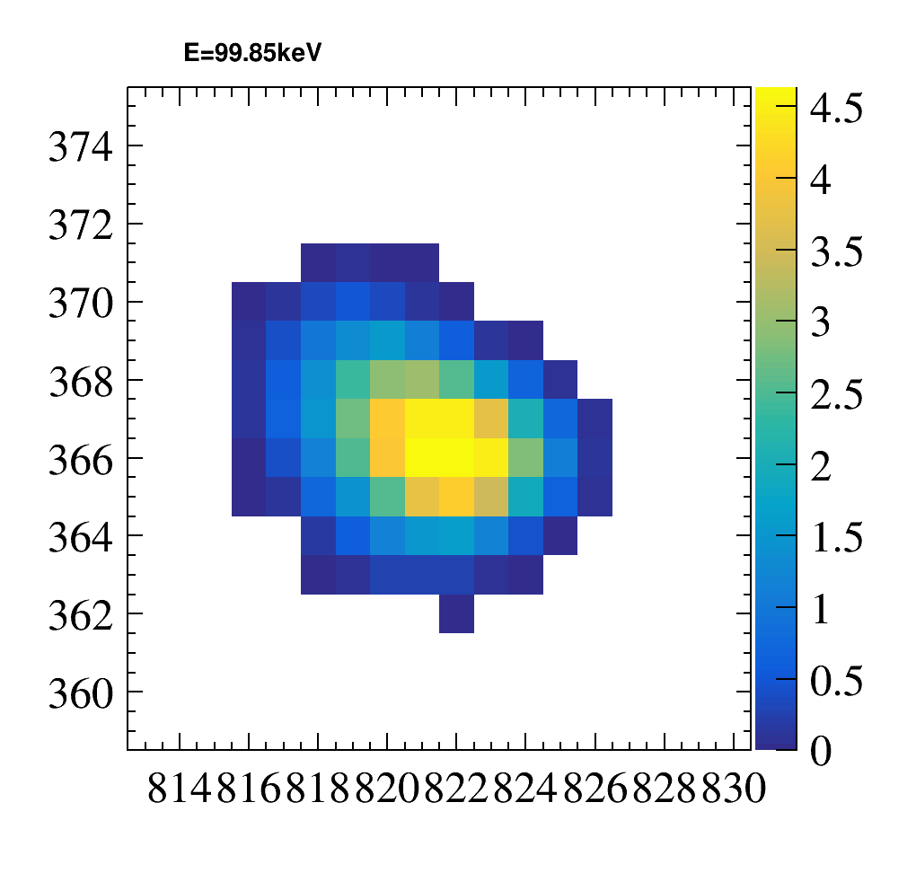
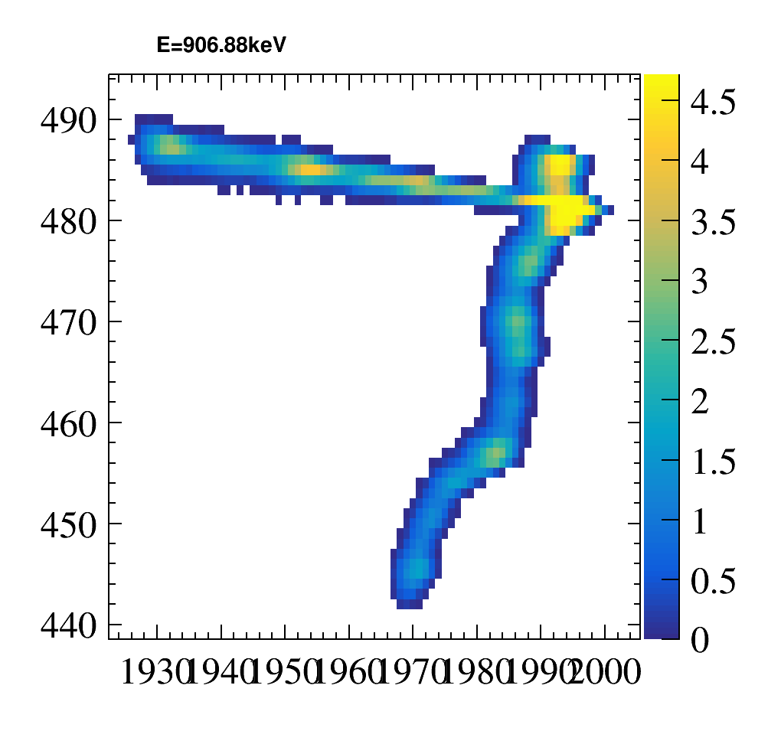
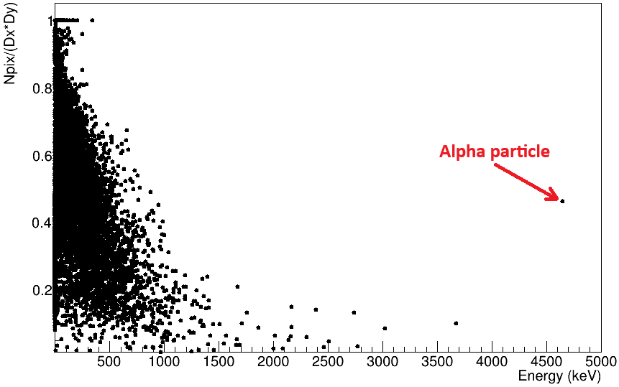
Particle Classification I
Create a DNN to classify particles arriving at our detector:
Electrons
Muons
Alpha
Serial register
Multiple events

Slide 32
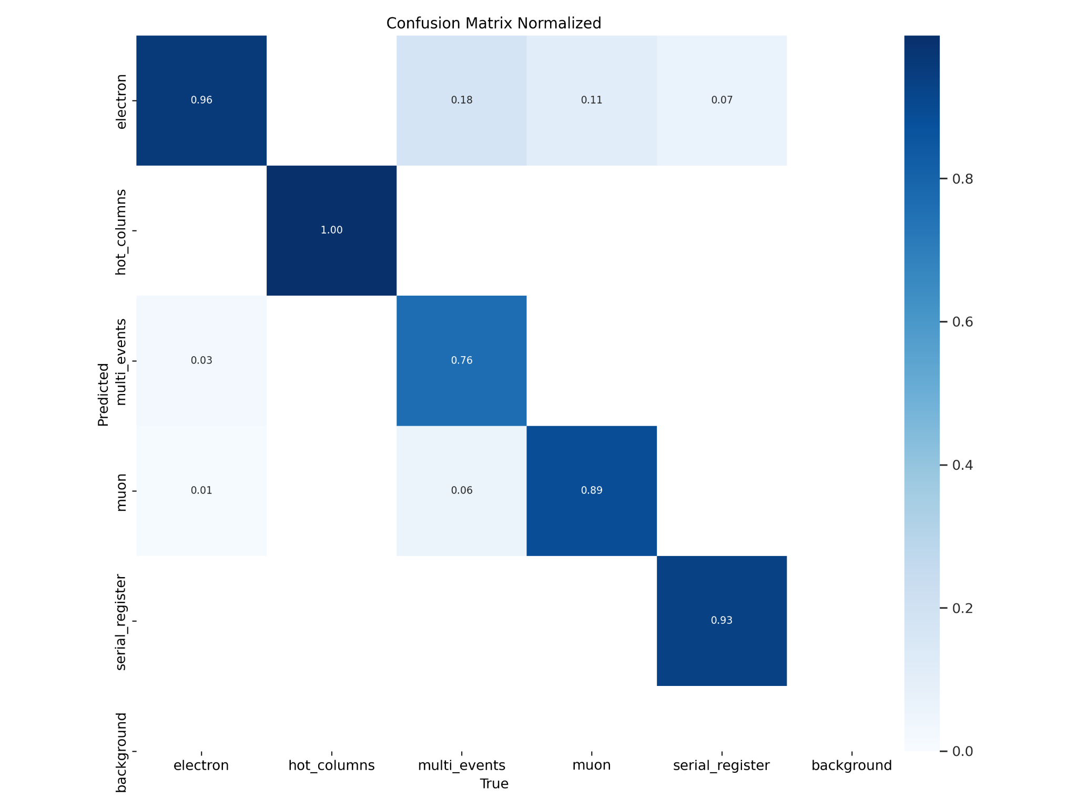

Particle Classification II
Simple model Complex model
Trace = 4.54 Trace = 4.52
YOLOv8 (You Only Look Once) model from Ultralytics
Train two pre-trained models with different complexity
300 epochs and a patience of 45 epochs

Slide 33
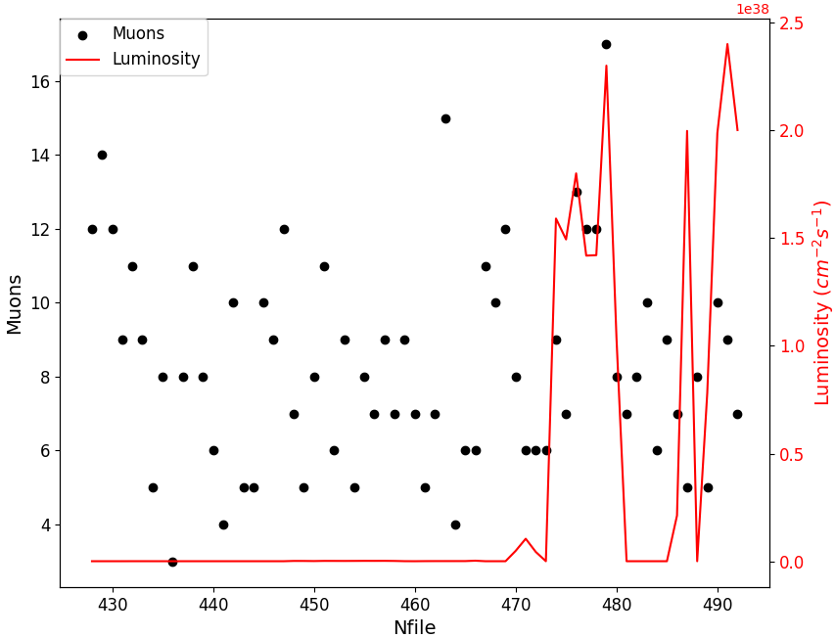
Number of Muons and Luminosity
Plot the number of muons detected with the DNN and the luminosity vs the time
No relation between the luminosity and the number of muons

Slide 34
Conclusions
We characterized the IRONMAN experimental setup at IFCA with new readout electronics, LTA.
We could not fully optimize the setup due to CCD quality issues, however we achieved a threshold improvement in electromagnetic noise:
By enhancing the grounding.
We developed:
A new metodology for the automated identification of hot columns.
A DNN for the classification of particles arriving the detector.
We found that the number of muons arriving at the setup is not proportional to the LHC luminosity.

Slide 35


THANKS FOR YOUR ATTENTION
QUESTIONS?

